Slide 1
Derivatives and linear approximations: multivariate functions

Slide 2
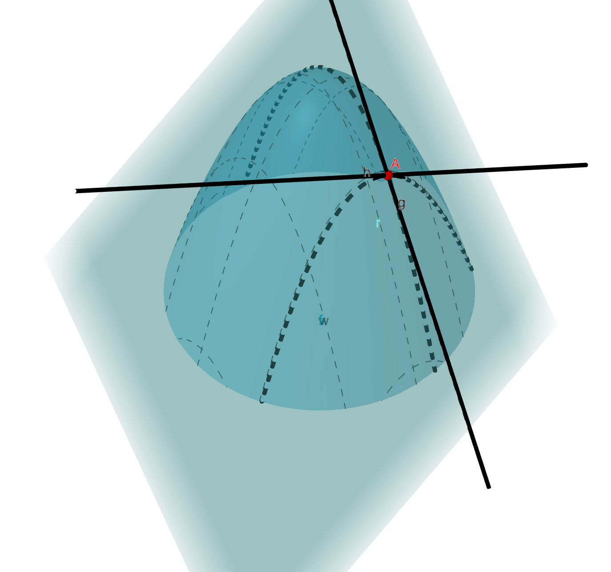
Introduction
We now know how to compute derivatives for single variate functions
Essentially, one should move over to the multivariate case
One should extrapolate the principle of the differentiability: to be approximated by straight line to be approximated by hyperplane

Slide 3
Tangent plane: motivation

Slide 4
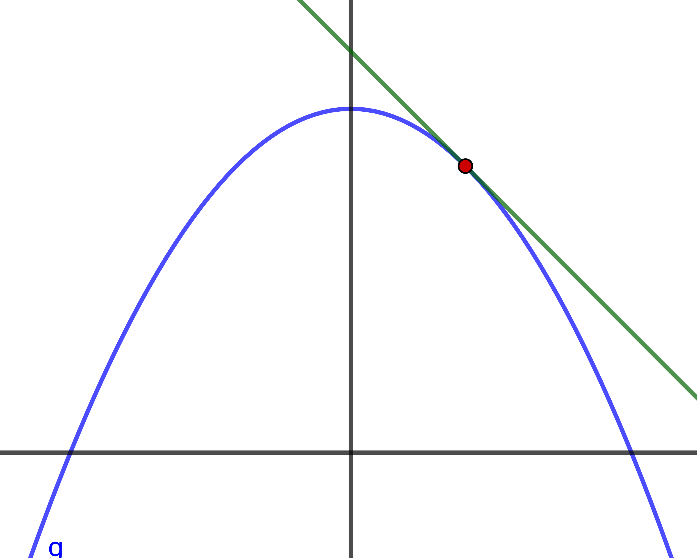
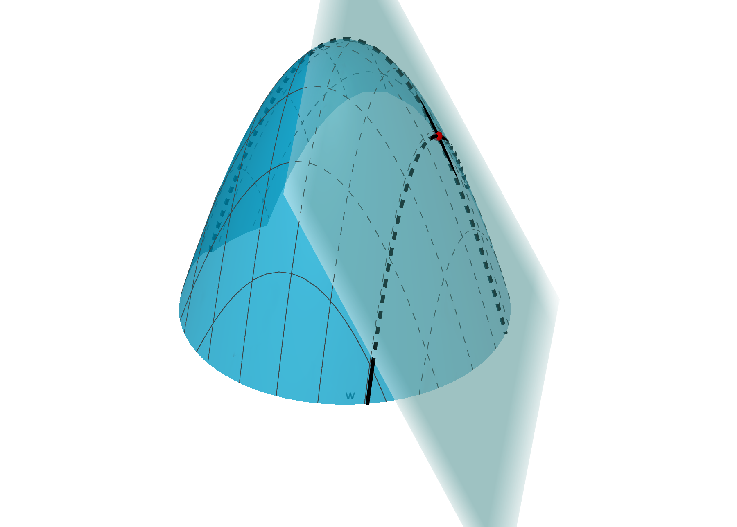
Tangent plane: definition
Let us try to generalize concept (in case of two variable functions):
tangent line ⟶ tangent plane

Slide 5
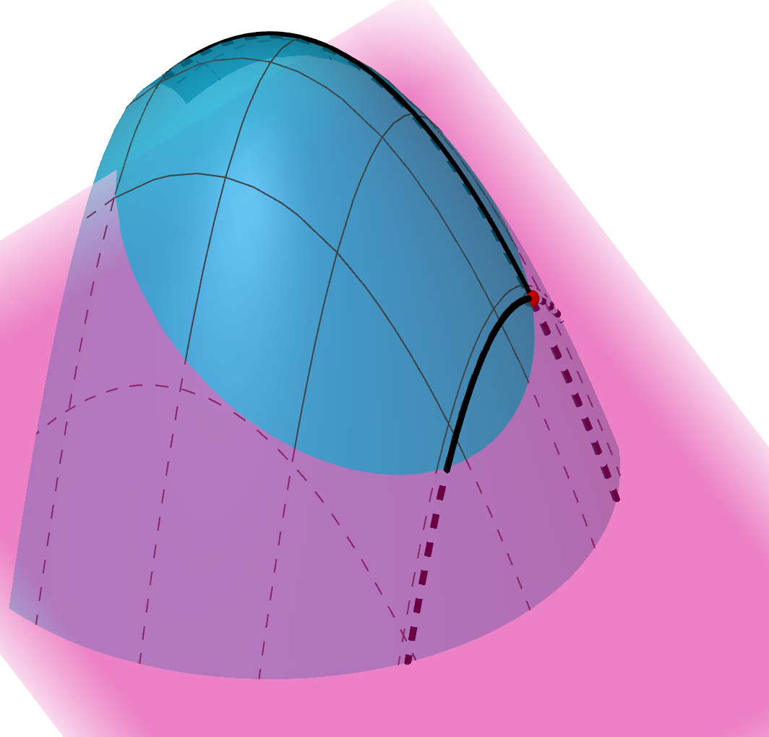
Tangent plane: definition
Let us try to generalize concept (in case of two variable functions):
tangent line ⟶ tangent plane
How one should define a tangent plane?
Essentially, a tangent plane can be defined as a limit of all secant planes.

Slide 6
Partial derivatives: definition

Slide 7
Partial derivatives: definition
Essentially, a tangent plane can be defined as a limit of all secant planes. Is it good definition? We need to find a more constructive approach!

Slide 8
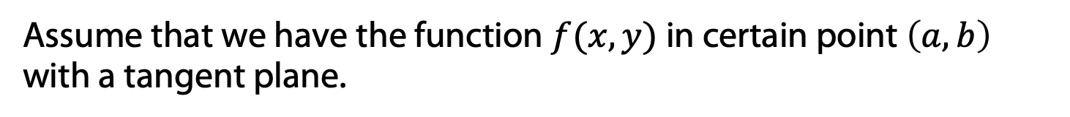
Partial derivatives: definition
Essentially, a tangent plane can be defined as a limit of all secant planes. Is it good definition? We need to find a more constructive approach!
Assume that we have the function $f(x,y)$ in certain point $\left(a,b\right)$ with a tangent plane.

Slide 9
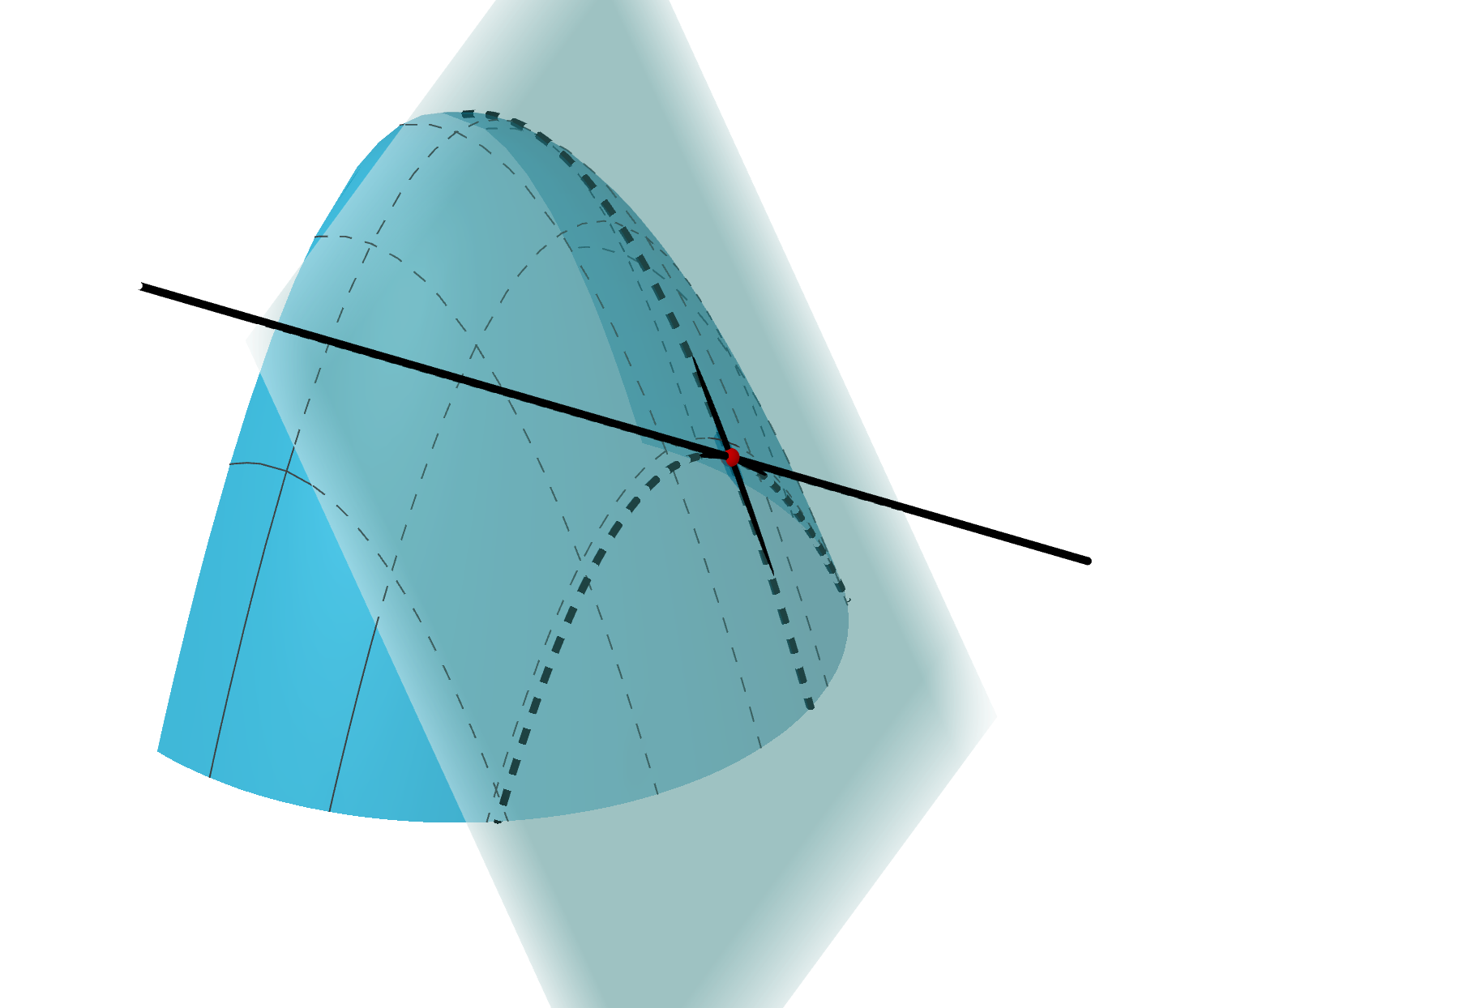
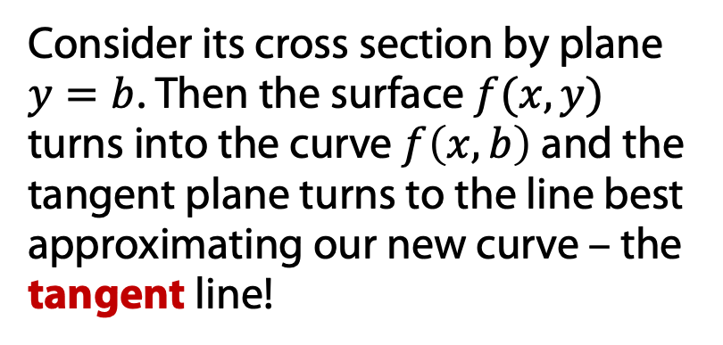
Partial derivatives: definition
Essentially, a tangent plane can be defined as a limit of all secant planes. Is it good definition? We need to find a more constructive approach!
Assume that we have the function $f(x,y)$ in certain point $\left(a,b\right)$ with a tangent plane.
Consider its cross section by plane $y=b$. Then the surface $f(x,y)$ turns into the curve $f\left(x,b\right)$and the tangent plane turns to the line best approximating our new curve – the tangent line!

Slide 10
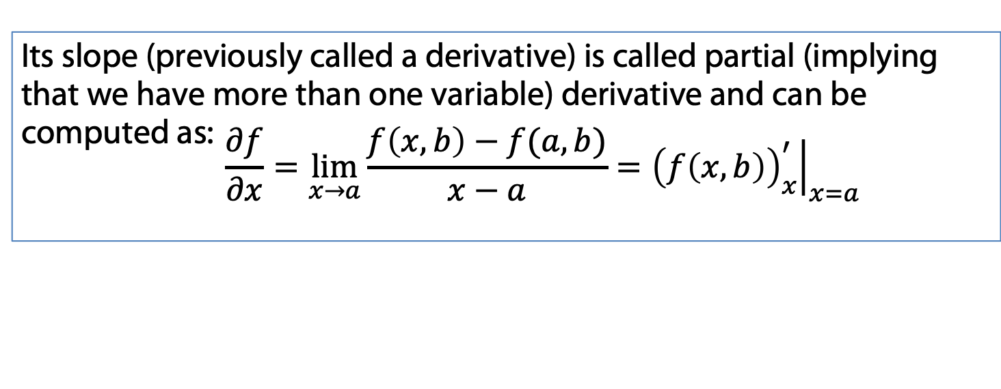
Partial derivatives: definition
Essentially, a tangent plane can be defined as a limit of all secant planes. Is it good definition? We need to find a more constructive approach!
Assume that we have the function $f(x,y)$ in certain point $\left(a,b\right)$ with a tangent plane.
Consider its cross section by plane $y=b$. Then the surface $f(x,y)$ turns into the curve $f\left(x,b\right)$and the tangent plane turns to the line best approximating our new curve – the tangent line!
Its slope (previously called a derivative) is called partial (implying that we have more than one variable) derivative and can be computed as: $$\frac{∂f}{∂x}=\lim_{x→a}{\frac{f\left(x,b\right)−f(a,b)}{x−a}}={\left.{\left(f\left(x,b\right)\right)}_{x}^{′}\right|}_{x=a}$$

Slide 11
Partial derivatives: examples

Slide 12
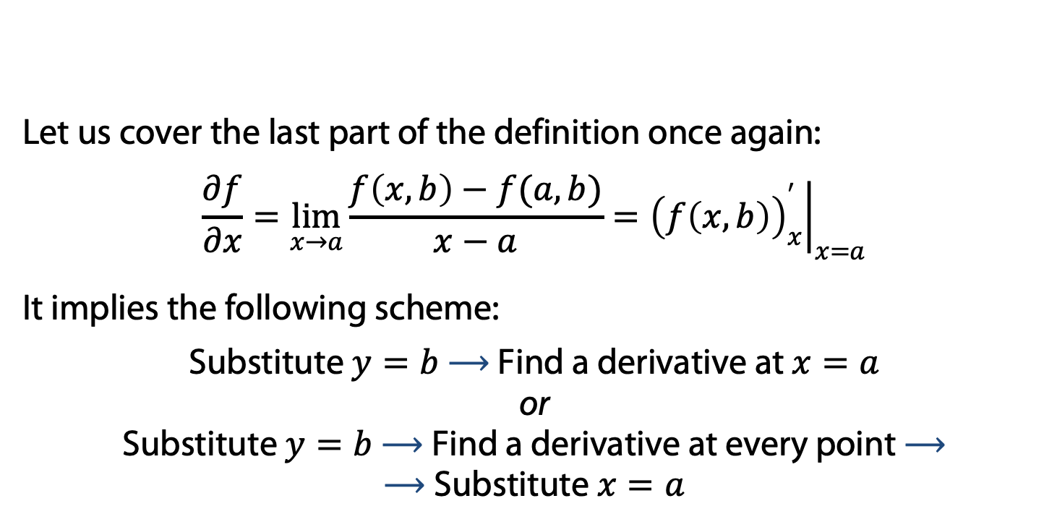
Partial derivatives: example
Let us cover the last part of the definition once again:
$$\frac{∂f}{∂x}=\lim_{x→a}{\frac{f\left(x,b\right)−f(a,b)}{x−a}}={\left.{\left(f\left(x,b\right)\right)}_{x}^{′}\right|}_{x=a}$$
It implies the following scheme:
Substitute $y=b$ ⟶ Find a derivative at $x=a$ or Substitute $y=b$ ⟶ Find a derivative at every point ⟶ ⟶ Substitute $x=a$

Slide 13
Partial derivatives: example
Let us cover the last part of the definition once again:
$$\frac{∂f}{∂x}=\lim_{x→a}{\frac{f\left(x,b\right)−f(a,b)}{x−a}}={\left.{\left(f\left(x,b\right)\right)}_{x}^{′}\right|}_{x=a}$$
It implies the following scheme:
Substitute $y=b$ ⟶ Find a derivative at $x=a$ or Substitute $y=b$ ⟶ Find a derivative at every point ⟶ ⟶ Substitute $x=a$
Example: $f\left(x,y\right)=\sqrt{\left|xy\right|}$ at $(0,0)$

Slide 14
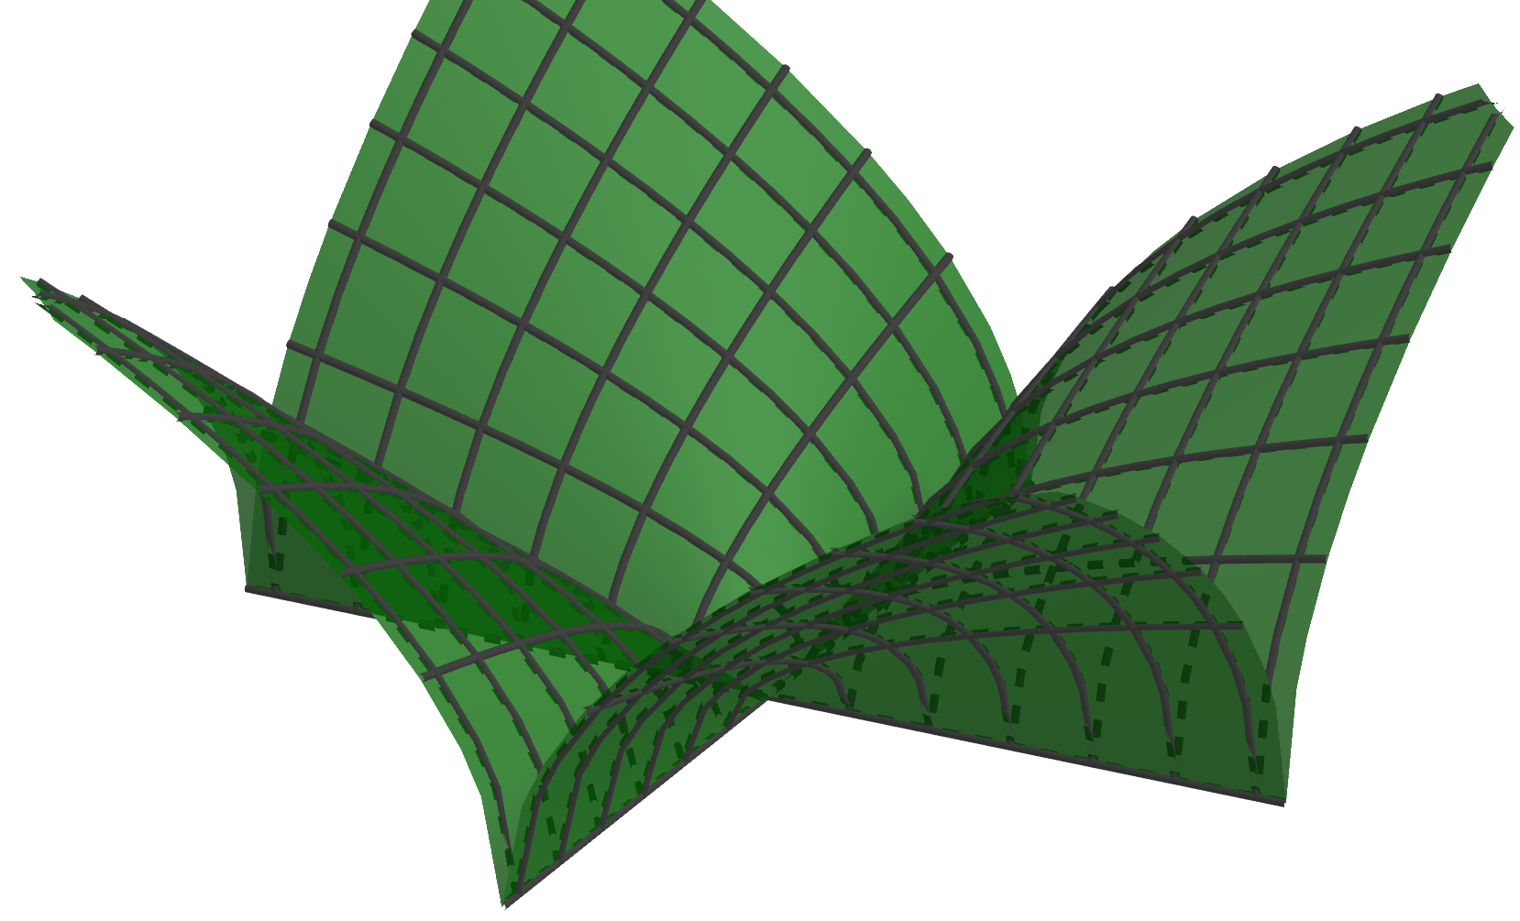
Partial derivatives: example
Let us cover the last part of the definition once again:
$$\frac{∂f}{∂x}=\lim_{x→a}{\frac{f\left(x,b\right)−f(a,b)}{x−a}}={\left.{\left(f\left(x,b\right)\right)}_{x}^{′}\right|}_{x=a}$$
It implies the following scheme:
Substitute $y=b$ ⟶ Find a derivative at $x=a$ or Substitute $y=b$ ⟶ Find a derivative at every point ⟶ ⟶ Substitute $x=a$
Example: $f\left(x,y\right)=\sqrt{\left|xy\right|}$ at $(0,0)$

Slide 15
Partial derivatives: example
Let us cover the last part of the definition once again:
$$\frac{∂f}{∂x}=\lim_{x→a}{\frac{f\left(x,b\right)−f(a,b)}{x−a}}={\left.{\left(f\left(x,b\right)\right)}_{x}^{′}\right|}_{x=a}$$
It implies the following scheme:
Substitute $y=b$ ⟶ Find a derivative at $x=a$ or Substitute $y=b$ ⟶ Find a derivative at every point ⟶ ⟶ Substitute $x=a$
Example: $f\left(x,y\right)=\left(x^{2}+y^{2}\right)\sin{xy}$ at $(a,b)$

Slide 16
Tangent plane: definition

Slide 17

Tangent plane: equation
So now we know at least two straight lines (tangent lines in cross sections $x=a$ and $y=b$) of the tangent plane. Is it enough to get an equation of a plane?

Slide 18
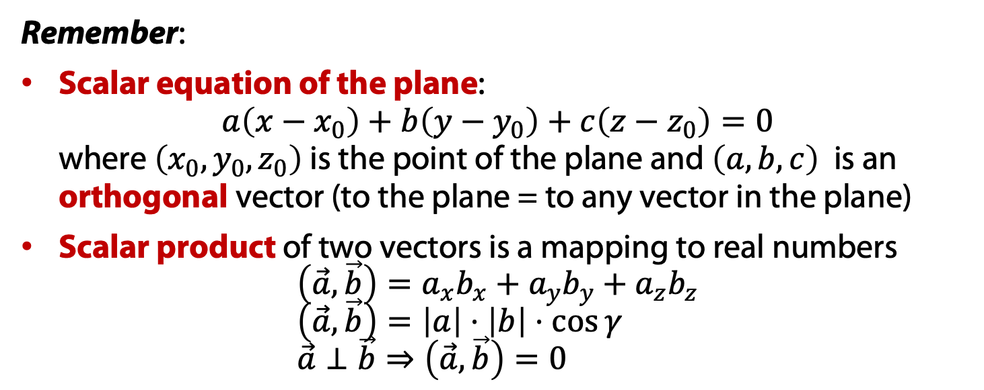
Tangent plane: equation
So now we know at least two straight lines (tangent lines in cross sections $x=a$ and $y=b$) of the tangent plane. Is it enough to get an equation of a plane?
Remember:
Scalar equation of the plane: $a\left(x−x_{0}\right)+b\left(y−y_{0}\right)+c\left(z−z_{0}\right)=0$ where $\left(x_{0},y_{0},z_{0}\right)$ is the point of the plane and $\left(a,b,c\right)$ is an orthogonal vector (to the plane = to any vector in the plane)
Scalar product of two vectors is a mapping to real numbers $\left(\vec{a},\vec{b}\right)=a_{x}b_{x}+a_{y}b_{y}+a_{z}b_{z}$ $\left(\vec{a},\vec{b}\right)=\left|a\right|⋅\left|b\right|⋅\cos{γ}$ $\vec{a}⊥\vec{b}⇒\left(\vec{a},\vec{b}\right)=0$

Slide 19

Tangent plane: equation
So now we know at least two straight lines (tangent lines in cross sections $x=a$ and $y=b$) of the tangent plane. Is it enough to get an equation of a plane?
Remember:
Scalar equation of the plane: $a\left(x−x_{0}\right)+b\left(y−y_{0}\right)+c\left(z−z_{0}\right)=0$ where $\left(x_{0},y_{0},z_{0}\right)$ is the point of the plane and $\left(a,b,c\right)$ is an orthogonal vector (to the plane = to any vector in the plane)
Scalar product of two vectors is a mapping to real numbers $\left(\vec{a},\vec{b}\right)=a_{x}b_{x}+a_{y}b_{y}+a_{z}b_{z}$ $\left(\vec{a},\vec{b}\right)=\left|a\right|⋅\left|b\right|⋅\cos{γ}$ $\vec{a}⊥\vec{b}⇒\left(\vec{a},\vec{b}\right)=0$
We know the point – it is $\left(a, b, f\left(a,b\right)\right).$ The orthogonal should be orthogonal to both direction vector of tangent lines:
$(1,0,f_{x}^{′}\left(a,b\right))$ and $(0,1,f_{x}^{′}\left(a,b\right))$

Slide 20

Tangent plane: equation
We know the point – it is $\left(a, b, f\left(a,b\right)\right).$ The orthogonal should be orthogonal to both direction vector of tangent lines:
$(1,0,f_{x}^{′}\left(a,b\right))$ and $(0,1,f_{x}^{′}\left(a,b\right))$

Slide 21
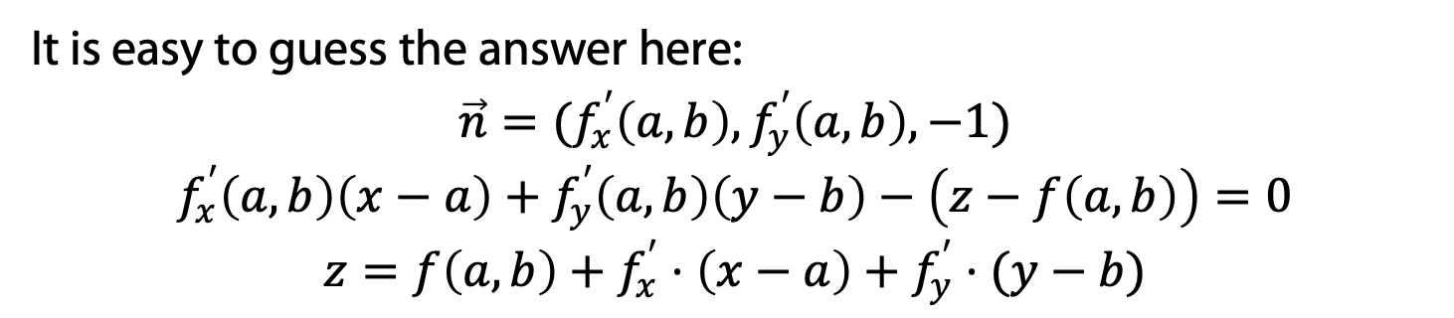
Tangent plane: equation
We know the point – it is $\left(a, b, f\left(a,b\right)\right).$ The orthogonal should be orthogonal to both direction vector of tangent lines:
$(1,0,f_{x}^{′}\left(a,b\right))$ and $(0,1,f_{x}^{′}\left(a,b\right))$
It is easy to guess the answer here:
$$\vec{n}=(f_{x}^{′}\left(a,b\right), f_{y}^{′}\left(a,b\right), −1)$$
$$f_{x}^{′}\left(a,b\right)\left(x−a\right)+f_{y}^{′}\left(a,b\right)\left(y−b\right)−\left(z−f\left(a,b\right)\right)=0$$
$$z=f\left(a,b\right)+f_{x}^{′}⋅\left(x−a\right)+f_{y}^{′}⋅(y−b)$$
Example:

Slide 22
Differentiability of multivariate function

Slide 23
Differentiability
Let us try then to generalize the concept of differentiability:
to be differentiable = to be “fittable” with plane object

Slide 24
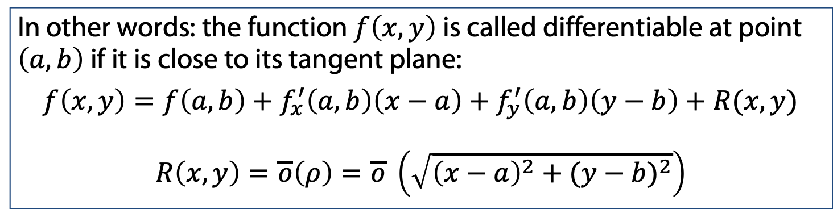
Differentiability
Let us try then to generalize the concept of differentiability:
to be differentiable = to be “fittable” with plane object
In other words: the function $f\left(x,y\right)$ is called differentiable at point $\left(a,b\right)$ if it is close to its tangent plane:
$$f\left(x,y\right)=f\left(a,b\right)+f_{x}^{′}\left(a,b\right)\left(x−a\right)+f_{y}^{′}\left(a,b\right)\left(y−b\right)+R(x,y)$$
$$R\left(x,y\right)=\overline{o}\left(ρ\right)=\overline{o} \left(\sqrt{{\left(x−a\right)}^{2}+({y−b)}^{2}}\right)$$

Slide 25
Differentiability
Let us try then to generalize the concept of differentiability:
to be differentiable = to be “fittable” with plane object
In other words: the function $f\left(x,y\right)$ is called differentiable at point $\left(a,b\right)$ if it is close to its tangent plane:
$$f\left(x,y\right)=f\left(a,b\right)+f_{x}^{′}\left(a,b\right)\left(x−a\right)+f_{y}^{′}\left(a,b\right)\left(y−b\right)+R(x,y)$$
$$R\left(x,y\right)=\overline{o}\left(ρ\right)=\overline{o} \left(\sqrt{{\left(x−a\right)}^{2}+({y−b)}^{2}}\right)$$
Note:
Single variate functions: differentiable = has a derivative
Multi variate functions: differentiable >> has partial derivatives

Slide 26
Differentiability of multivariate function: examples

Slide 27
Differentiability
Note:
Single variate functions: differentiable = has a derivative
Multi variate functions: differentiable >> has partial derivatives

Slide 28
Differentiability
Note:
Single variate functions: differentiable = has a derivative
Multi variate functions: differentiable >> has partial derivatives
Example: $f\left(x,y\right)=\sqrt{\left|xy\right|}$ at $(0,0)$

Slide 29
Differentiability
Note:
Single variate functions: differentiable = has a derivative
Multi variate functions: differentiable >> has partial derivatives
Example: $f\left(x,y\right)=\sqrt{\left|xy\right|}$ at $(0,0)$

Slide 30
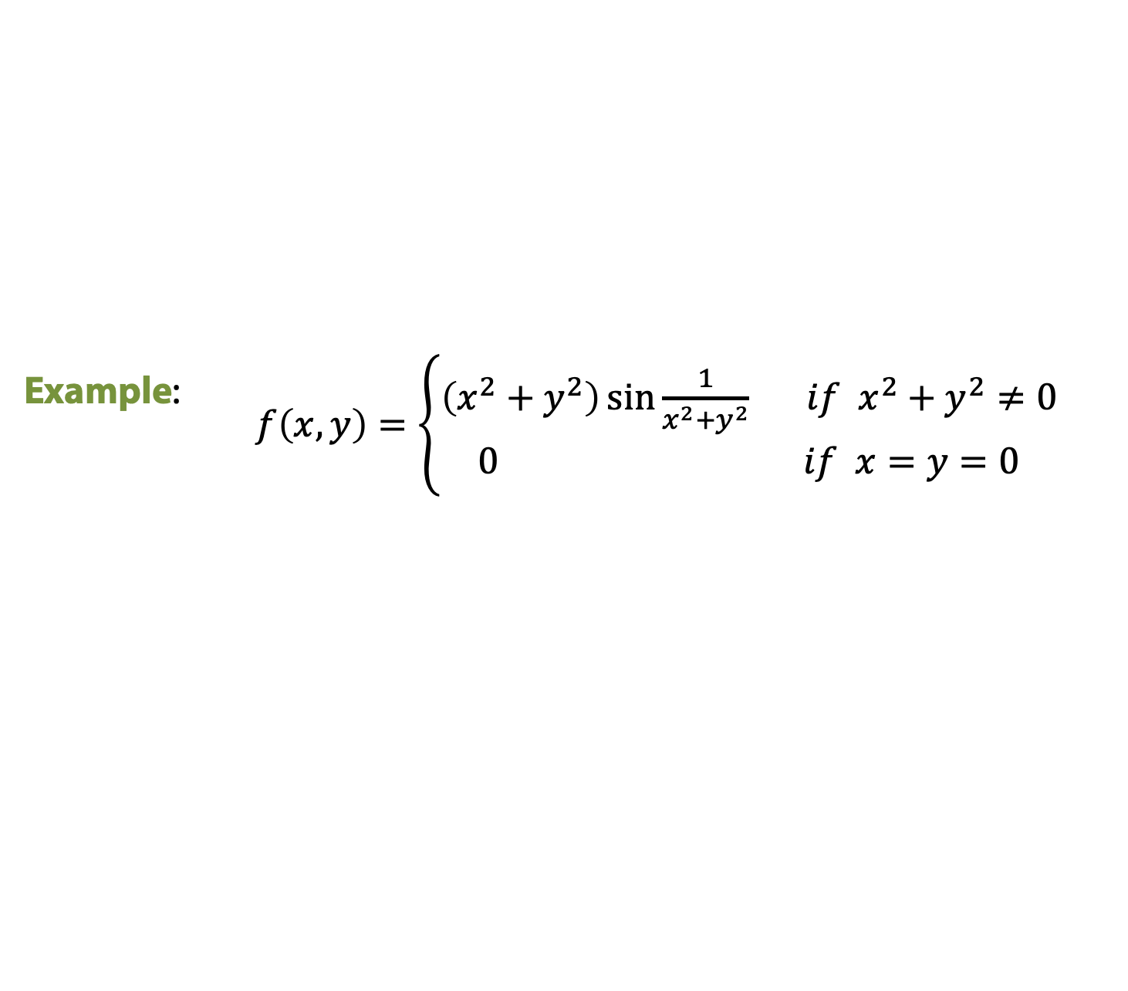
Differentiability
Note:
Single variate functions: differentiable = has a derivative
Multi variate functions: differentiable >> has partial derivatives
Example:
$f\left(x,y\right)=\left\{\begin{aligned}\left(x^{2}+y^{2}\right)\sin{\frac{1}{x^{2}+y^{2}}} if x^{2}+y^{2}≠0 \\ 0 if x=y=0\end{aligned}\right.$

Slide 31
Differentiability: sufficient condition

Slide 32
Differentiability: sufficient condition
If the existence of both partial derivatives is not enough (but necessary) for function in order to be differentiable, then what is? Should we always check this comprehensive definition?

Slide 33
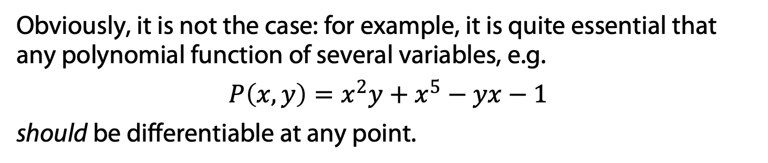
Differentiability: sufficient condition
If the existence of both partial derivatives is not enough (but necessary) for function in order to be differentiable, then what is? Should we always check this comprehensive definition?
Obviously, it is not the case: for example, it is quite essential that any polynomial function of several variables, e.g.
$$P\left(x,y\right)=x^{2}y+x^{5}−yx−1$$
should be differentiable at any point.

Slide 34
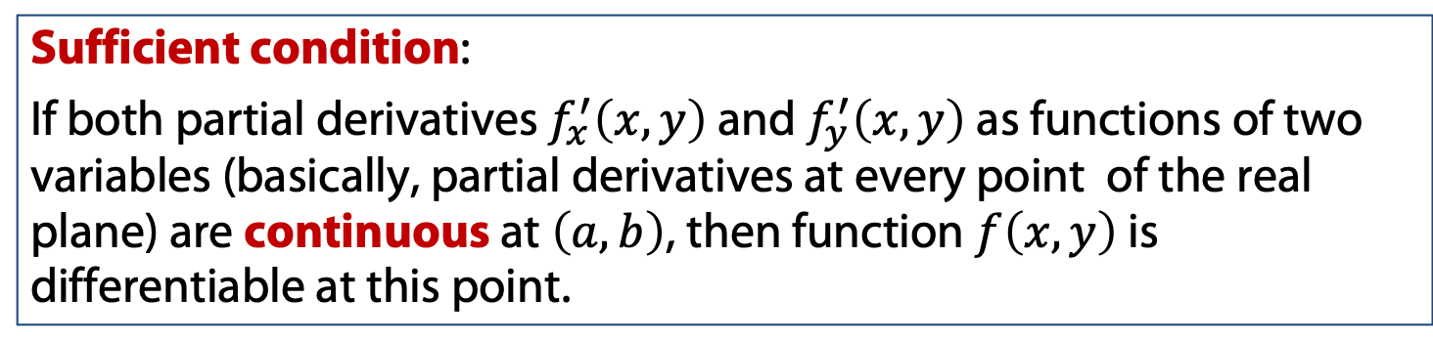
Differentiability: sufficient condition
If the existence of both partial derivatives is not enough (but necessary) for function in order to be differentiable, then what is? Should we always check this comprehensive definition?
Obviously, it is not the case: for example, it is quite essential that any polynomial function of several variables, e.g.
$$P\left(x,y\right)=x^{2}y+x^{5}−yx−1$$
should be differentiable at any point.
Sufficient condition:
If both partial derivatives $f_{x}^{′}\left(x,y\right)$ and $f_{y}^{′}\left(x,y\right)$ as functions of two variables (basically, partial derivatives at every point of the real plane) are continuous at $\left(a,b\right)$, then function $f\left(x,y\right)$ is differentiable at this point.

Slide 35
Basic geometry and Gradient

Slide 36
Basic geometry
Let us revisit once again the very first concepts of vector spaces and scalar (dot) products.

Slide 37
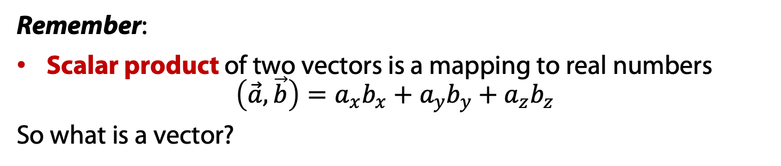
Basic geometry
Let us revisit once again the very first concepts of vector spaces and scalar (dot) products.
Remember:
Scalar product of two vectors is a mapping to real numbers $\left(\vec{a},\vec{b}\right)=a_{x}b_{x}+a_{y}b_{y}+a_{z}b_{z}$
So what is a vector?

Slide 38
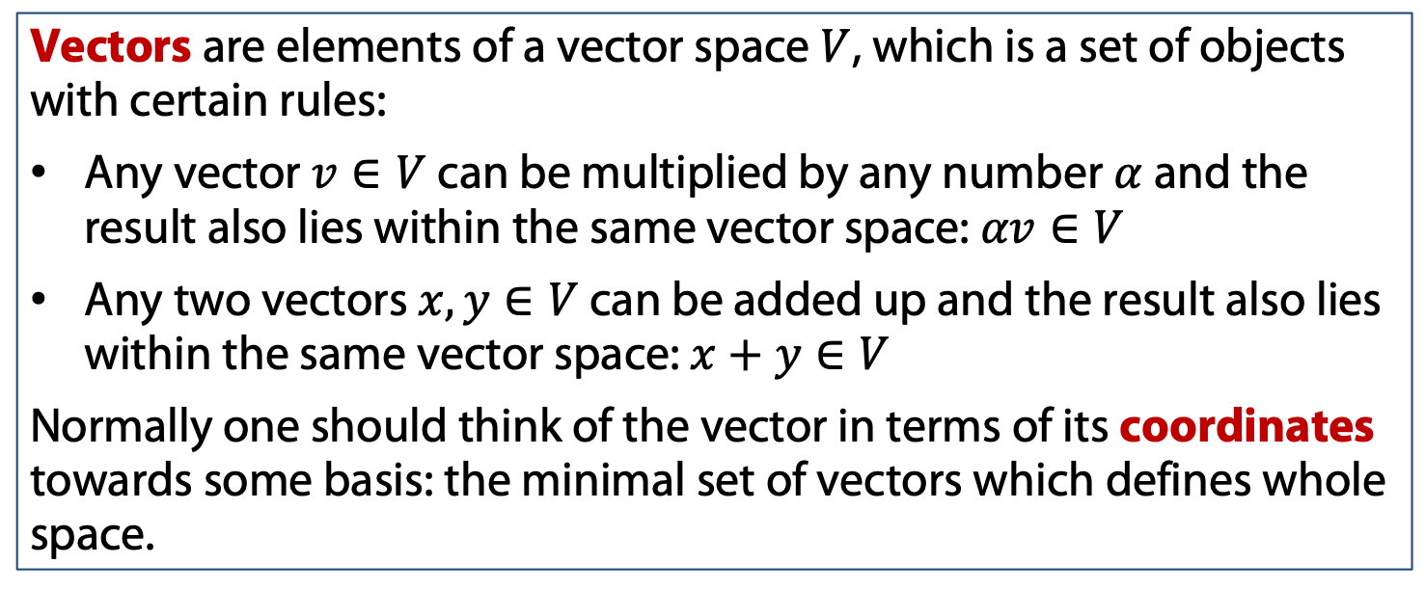
Basic geometry
Let us revisit once again the very first concepts of vector spaces and scalar (dot) products.
Remember:
Scalar product of two vectors is a mapping to real numbers $\left(\vec{a},\vec{b}\right)=a_{x}b_{x}+a_{y}b_{y}+a_{z}b_{z}$
So what is a vector?
Vectors are elements of a vector space $V$, which is a set of objects with certain rules:
Any vector $v∈V$ can be multiplied by any number $α$ and the result also lies within the same vector space: $αv∈V$
Any two vectors $x,y∈V$ can be added up and the result also lies within the same vector space: $x+y∈V$
Normally one should think of the vector in terms of its coordinates towards some basis: the minimal set of vectors which defines whole space.

Slide 39
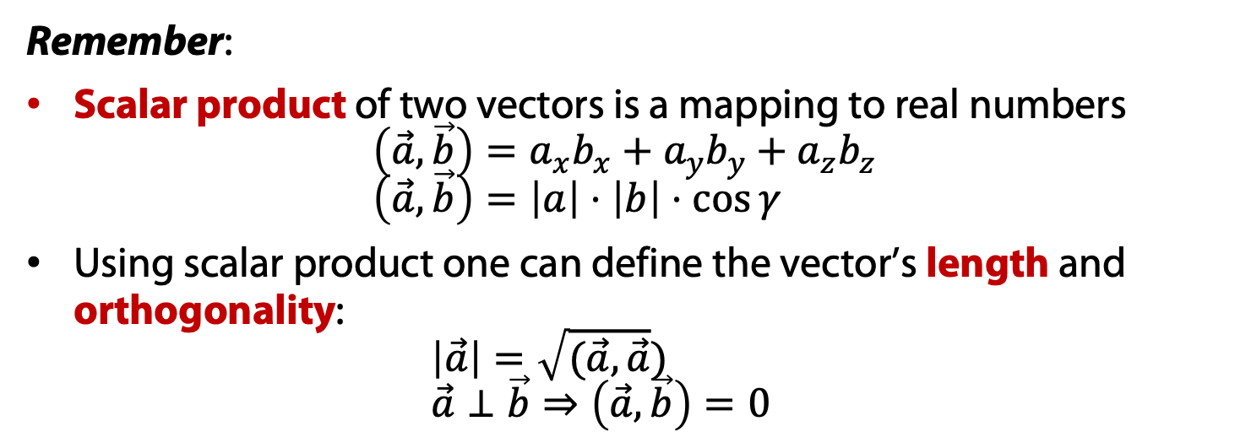
Basic geometry and Gradient
Remember:
Scalar product of two vectors is a mapping to real numbers $\left(\vec{a},\vec{b}\right)=a_{x}b_{x}+a_{y}b_{y}+a_{z}b_{z}$ $\left(\vec{a},\vec{b}\right)=\left|a\right|⋅\left|b\right|⋅\cos{γ}$
Using scalar product one can define the vector’s length and orthogonality: $\left|\vec{a}\right|=\sqrt{(\vec{a},\vec{a}})$ $\vec{a}⊥\vec{b}⇒\left(\vec{a},\vec{b}\right)=0$

Slide 40
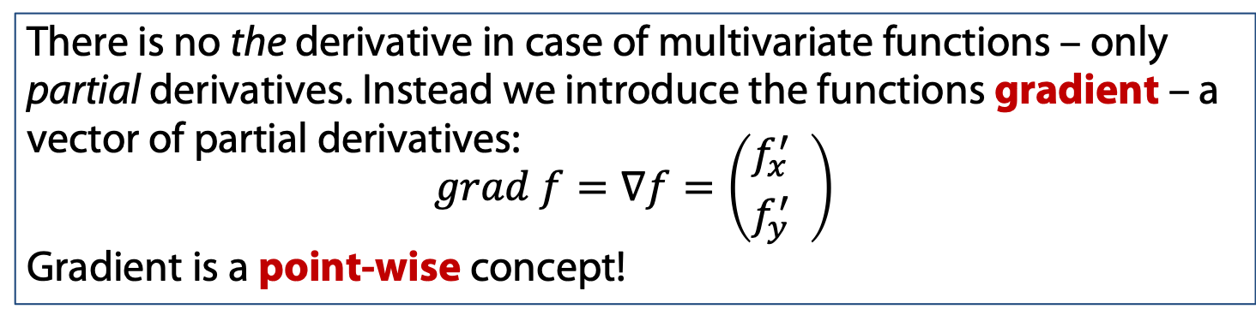
Basic geometry and Gradient
Remember:
Scalar product of two vectors is a mapping to real numbers $\left(\vec{a},\vec{b}\right)=a_{x}b_{x}+a_{y}b_{y}+a_{z}b_{z}$ $\left(\vec{a},\vec{b}\right)=\left|a\right|⋅\left|b\right|⋅\cos{γ}$
Using scalar product one can define the vector’s length and orthogonality: $\left|\vec{a}\right|=\sqrt{(\vec{a},\vec{a}})$ $\vec{a}⊥\vec{b}⇒\left(\vec{a},\vec{b}\right)=0$
There is no the derivative in case of multivariate functions – only partial derivatives. Instead we introduce the functions gradient – a vector of partial derivatives:
$$grad f=∇f=\left({f_{x}^{′} \atop f_{y}^{′}} \right)$$
Gradient is a point-wise concept!

Slide 41
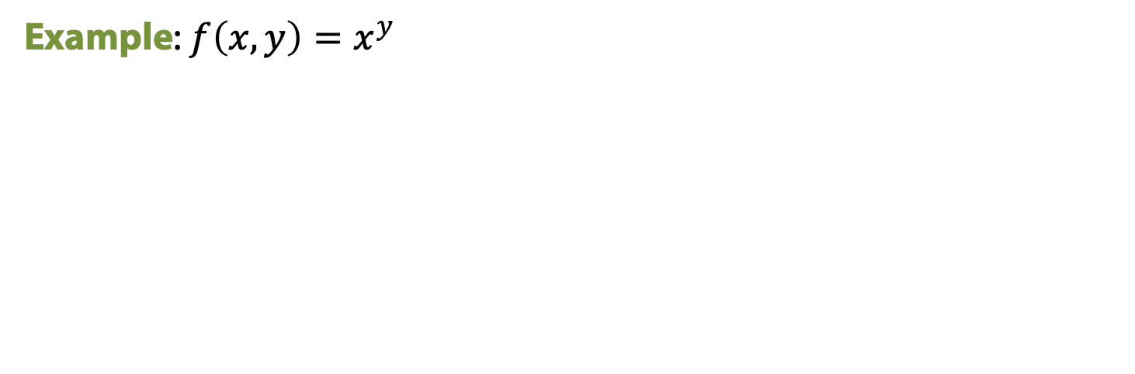
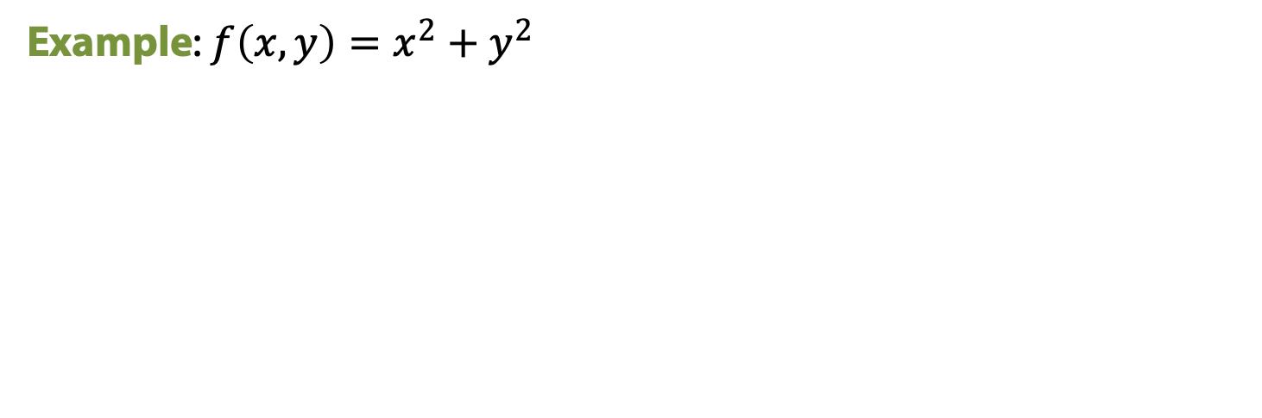
Gradient
Example: $f\left(x,y\right)=x^{2}+y^{2}$
Example: $f\left(x,y\right)=x^{y}$

Slide 42
Chain rule: one independent variable

Slide 43

Chain rule: multivariate case
Assume that we have some multivariate function $f\left(x,y\right)$ where both variables are dependent ($x=x\left(t\right)$ and $y=y(t)$) on some other independent variable $t$.

Slide 44
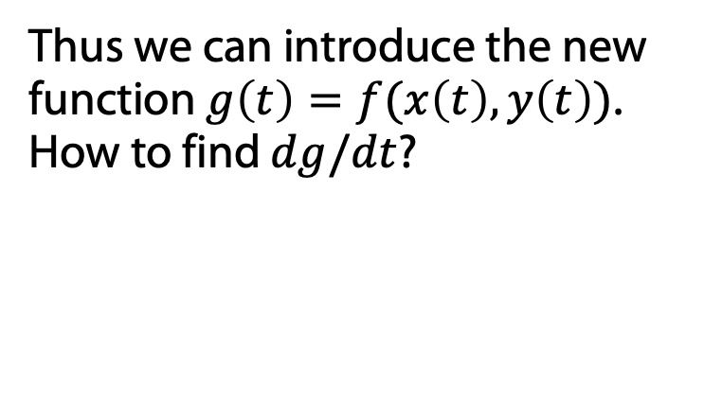
Chain rule: multivariate case
Assume that we have some multivariate function $f\left(x,y\right)$ where both variables are dependent ($x=x\left(t\right)$ and $y=y(t)$) on some other independent variable $t$.
Thus we can introduce the new function $g\left(t\right)=f(x\left(t\right),y\left(t\right))$. How to find $dg/dt$?
x
t
f
y

Slide 45

Chain rule: multivariate case
Assume that we have some multivariate function $f\left(x,y\right)$ where both variables are dependent ($x=x\left(t\right)$ and $y=y(t)$) on some other independent variable $t$.
Thus we can introduce the new function $g\left(t\right)=f(x\left(t\right),y\left(t\right))$. How to find $dg/dt$?
x
t
f
y
Example: $f\left(x,y\right)=xy^{2}$, $x\left(t\right)=t$, $y\left(t\right)=t^{2}$

Slide 46

Chain rule: multivariate case
Assume that we have some multivariate function $f\left(x,y\right)$ where both variables are dependent ($x=x\left(t\right)$ and $y=y(t)$) on some other independent variable $t$.
Thus we can introduce the new function $g\left(t\right)=f(x\left(t\right),y\left(t\right))$. How to find $dg/dt$?
x
t
f
y
Example: $f\left(x,y\right)=xy^{2}$, $x\left(t\right)=t$, $y\left(t\right)=t^{2}$
The chain rule states:
$$\frac{df}{dt}=\frac{∂f }{∂x}⋅\frac{dx}{dt}+\frac{∂f}{∂y}⋅\frac{dy}{dt}$$

Slide 47
Chain rule: vector form

Slide 48

Chain rule: vector form
Assume that we have some multivariate function $f\left(x,y\right)$ where both variables are dependent ($x=x\left(t\right)$ and $y=y(t)$) on some other independent variable $t$.
The chain rule states:
$$\frac{df}{dt}=\frac{∂f }{∂x}⋅\frac{dx}{dt}+\frac{∂f}{∂y}⋅\frac{dy}{dt}$$
Since we defined more powerful concept earlier, let us rewrite the rule in a fancier manner.

Slide 49
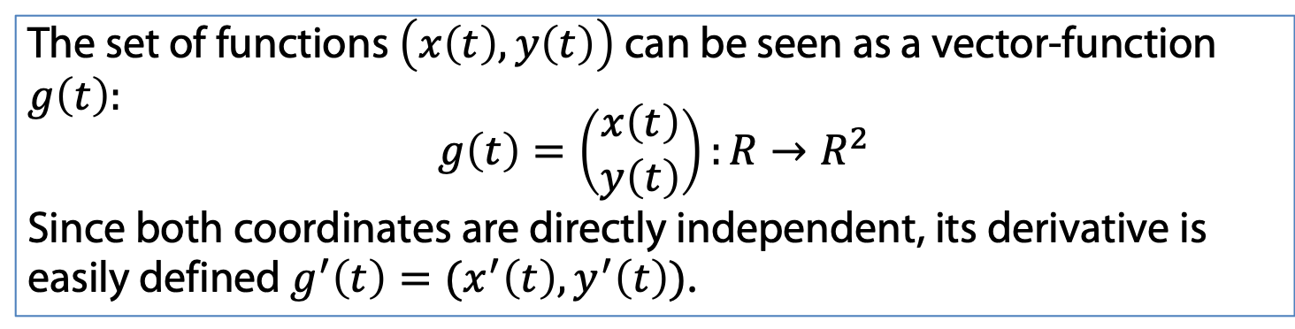
Chain rule: vector form
Assume that we have some multivariate function $f\left(x,y\right)$ where both variables are dependent ($x=x\left(t\right)$ and $y=y(t)$) on some other independent variable $t$.
The chain rule states:
$$\frac{df}{dt}=\frac{∂f }{∂x}⋅\frac{dx}{dt}+\frac{∂f}{∂y}⋅\frac{dy}{dt}$$
Since we defined more powerful concept earlier, let us rewrite the rule in a fancier manner.
The set of functions $\left(x\left(t\right),y\left(t\right)\right)$ can be seen as a vector-function $g\left(t\right):$
$$g\left(t\right)=\left(\begin{matrix}x\left(t\right) \\ y\left(t\right)\end{matrix}\right):R→R^{2}$$
Since both coordinates are directly independent, its derivative is easily defined $g^{′}\left(t\right)=(x^{′}\left(t\right), y^{′}\left(t\right))$.

Slide 50


Chain rule: vector form
Assume that we have some multivariate function $f\left(x,y\right)$ where both variables are dependent ($x=x\left(t\right)$ and $y=y(t)$) on some other independent variable $t$.
The chain rule states:
$$\frac{df}{dt}=\frac{∂f }{∂x}⋅\frac{dx}{dt}+\frac{∂f}{∂y}⋅\frac{dy}{dt}$$
Since we defined more powerful concept earlier, let us rewrite the rule in a fancier manner.
The set of functions $\left(x\left(t\right),y\left(t\right)\right)$ can be seen as a vector-function $g\left(t\right):$
$$g\left(t\right)=\left(\begin{matrix}x\left(t\right) \\ y\left(t\right)\end{matrix}\right):R→R^{2}$$
Since both coordinates are directly independent, its derivative is easily defined $g^{′}\left(t\right)=(x^{′}\left(t\right), y^{′}\left(t\right))$.
As a result we get:
$$\frac{df}{dt}=\frac{∂f }{∂x}⋅\frac{dx}{dt}+\frac{∂f}{∂y}⋅\frac{dy}{dt}=(∇f,g^{′}\left(t\right))$$

Slide 51
Chain rule: several independent variable

Slide 52
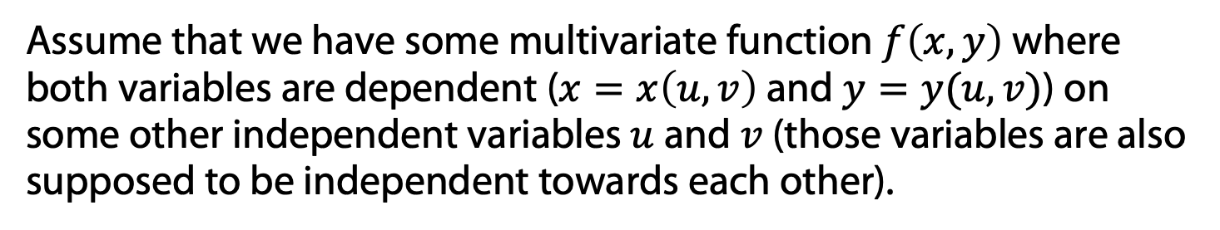
Chain rule: multivariate case
Assume that we have some multivariate function $f\left(x,y\right)$ where both variables are dependent ($x=x\left(u,v\right)$ and $y=y(u,v)$) on some other independent variables $u$ and $v$ (those variables are also supposed to be independent towards each other).

Slide 53
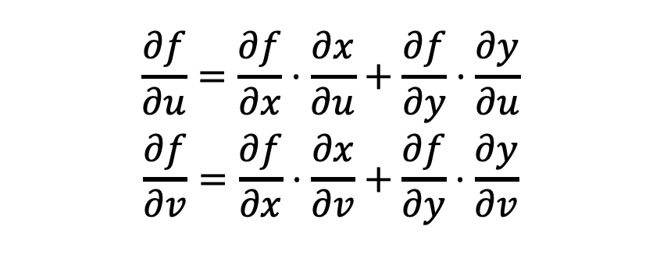
Chain rule: multivariate case
Assume that we have some multivariate function $f\left(x,y\right)$ where both variables are dependent ($x=x\left(u,v\right)$ and $y=y(u,v)$) on some other independent variables $u$ and $v$ (those variables are also supposed to be independent towards each other).
$$\frac{∂f}{∂u}=\frac{∂f}{∂x}⋅\frac{∂x}{∂u}+\frac{∂f}{∂y}⋅\frac{∂y}{∂u}$$
$$\frac{∂f}{∂v}=\frac{∂f}{∂x}⋅\frac{∂x}{∂v}+\frac{∂f}{∂y}⋅\frac{∂y}{∂v}$$
u
x
f
v
y

Slide 54

Chain rule: multivariate case
Assume that we have some multivariate function $f\left(x,y\right)$ where both variables are dependent ($x=x\left(u,v\right)$ and $y=y(u,v)$) on some other independent variables $u$ and $v$ (those variables are also supposed to be independent towards each other).
$$\frac{∂f}{∂u}=\frac{∂f}{∂x}⋅\frac{∂x}{∂u}+\frac{∂f}{∂y}⋅\frac{∂y}{∂u}$$
$$\frac{∂f}{∂v}=\frac{∂f}{∂x}⋅\frac{∂x}{∂v}+\frac{∂f}{∂y}⋅\frac{∂y}{∂v}$$
u
x
f
v
y
Example: $f\left(x,y\right)=xy^{2}$, $x\left(u,v\right)=u+v$, $y\left(t\right)=u−v$

Slide 55
Second partial derivatives

Slide 56
Second partial derivatives
The transition from the concept of partial derivatives to the concept of second derivatives.
$$f(x,y)$$
𝑓(𝑥,𝑦)
$$f_{x}^{′}\left(x,y\right)$$
𝑓_𝑥^′ (𝑥,𝑦)
$$f_{xx}^{′′}\left(x,y\right)$$
𝑓_𝑥𝑥^′′ (𝑥,𝑦)
$$f_{xy}^{′′}\left(x,y\right)$$
𝑓_𝑥𝑦^′′ (𝑥,𝑦)
$$f_{y}^{′}\left(x,y\right)$$
𝑓_𝑦^′ (𝑥,𝑦)
$$f_{yx}^{′′}\left(x,y\right)$$
𝑓_𝑦𝑥^′′ (𝑥,𝑦)
Function
Partial Derivatives
Second partial derivatives
$$f_{yy}^{′′}\left(x,y\right)$$
𝑓_𝑦𝑦^′′ (𝑥,𝑦)
by x
by x
by y
by y
by x
by y

Slide 57

Second partial derivatives
The transition from the concept of partial derivatives to the concept of second derivatives.
$$f(x,y)$$
𝑓(𝑥,𝑦)
$$f_{x}^{′}\left(x,y\right)$$
𝑓_𝑥^′ (𝑥,𝑦)
$$f_{xx}^{′′}\left(x,y\right)$$
𝑓_𝑥𝑥^′′ (𝑥,𝑦)
$$f_{xy}^{′′}\left(x,y\right)$$
𝑓_𝑥𝑦^′′ (𝑥,𝑦)
$$f_{y}^{′}\left(x,y\right)$$
𝑓_𝑦^′ (𝑥,𝑦)
$$f_{yx}^{′′}\left(x,y\right)$$
𝑓_𝑦𝑥^′′ (𝑥,𝑦)
Function
Partial Derivatives
Second partial derivatives
$$f_{yy}^{′′}\left(x,y\right)$$
𝑓_𝑦𝑦^′′ (𝑥,𝑦)
by x
by x
by y
by y
by x
by y
The idea here stands the same as in the singlevariate case:
$$f_{xy}^{′′}\left(x,y\right)={\left(f_{x}^{′}(x,y)\right)}_{y}^{′}$$

Slide 58
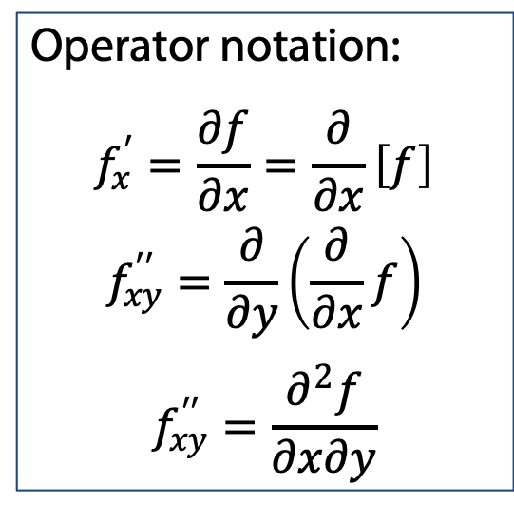
Second partial derivatives
The transition from the concept of partial derivatives to the concept of second derivatives.
$$f(x,y)$$
𝑓(𝑥,𝑦)
$$f_{x}^{′}\left(x,y\right)$$
𝑓_𝑥^′ (𝑥,𝑦)
$$f_{xx}^{′′}\left(x,y\right)$$
𝑓_𝑥𝑥^′′ (𝑥,𝑦)
$$f_{xy}^{′′}\left(x,y\right)$$
𝑓_𝑥𝑦^′′ (𝑥,𝑦)
$$f_{y}^{′}\left(x,y\right)$$
𝑓_𝑦^′ (𝑥,𝑦)
$$f_{yx}^{′′}\left(x,y\right)$$
𝑓_𝑦𝑥^′′ (𝑥,𝑦)
Function
Partial Derivatives
Second partial derivatives
$$f_{yy}^{′′}\left(x,y\right)$$
𝑓_𝑦𝑦^′′ (𝑥,𝑦)
Operator notation:
$$f_{x}^{′}=\frac{∂f}{∂x}=\frac{∂}{∂x}\left[f\right]$$
$$f_{xy}^{′′}=\frac{∂}{∂y}\left(\frac{∂}{∂x}f\right)$$
$$f_{xy}^{′′}=\frac{∂^{2}f}{∂x∂y}$$
by x
by x
by y
by y
by x
by y
The idea here stands the same as in the singlevariate case:
$$f_{xy}^{′′}\left(x,y\right)={\left(f_{x}^{′}(x,y)\right)}_{y}^{′}$$

Slide 59
Second partial derivatives
Example: $f\left(x,y\right)=x^{y^{2}}$. Find all second derivatives.

Slide 60
Second partial derivatives: order of derivatives

Slide 61

Second partial derivatives
Let us review our second derivatives once again: do the order of differentiation matter?
Does this two derivatives necessarily coincide?
$$\frac{∂^{2}f}{∂x∂y}\left(a,b\right) and \frac{∂^{2}f}{∂y∂x}\left(a,b\right)$$

Slide 62
Second partial derivatives
Let us review our second derivatives once again: do the order of differentiation matter?
Does this two derivatives necessarily coincide?
$$\frac{∂^{2}f}{∂x∂y}\left(a,b\right) and \frac{∂^{2}f}{∂y∂x}\left(a,b\right)$$
Generally speaking, the order matters! This fact concerns famous Clairaut's theorem: one can actually construct a function with two existent but not coinciding second derivatives.

Slide 63
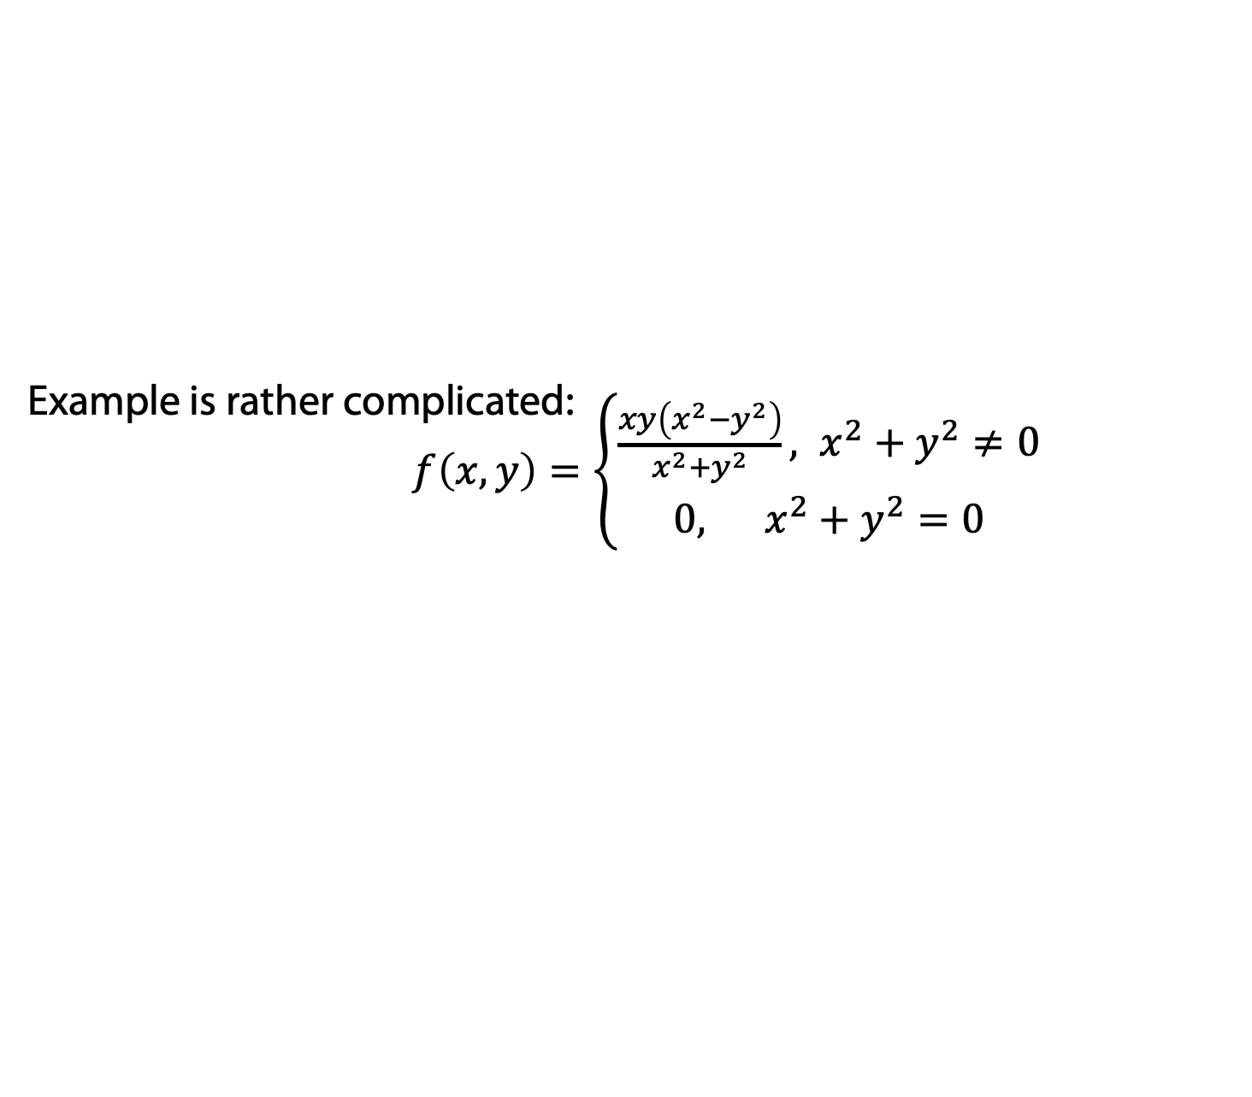
Second partial derivatives
Let us review our second derivatives once again: do the order of differentiation matter?
Does this two derivatives necessarily coincide?
$$\frac{∂^{2}f}{∂x∂y}\left(a,b\right) and \frac{∂^{2}f}{∂y∂x}\left(a,b\right)$$
Generally speaking, the order matters! This fact concerns famous Clairaut's theorem: one can actually construct a function with two existent but not coinciding second derivatives.
Example is rather complicated: $f\left(x,y\right)=\left\{\begin{aligned}\frac{xy\left(x^{2}−y^{2}\right)}{x^{2}+y^{2}}, x^{2}+y^{2}≠0 \\ 0, x^{2}+y^{2}=0\end{aligned}\right.$
The sufficient condition is continuality of compared derivatives. More narrow and simpler idea: the existence of higher derivative.

Slide 64
Differentials of multivariate functions

Slide 65
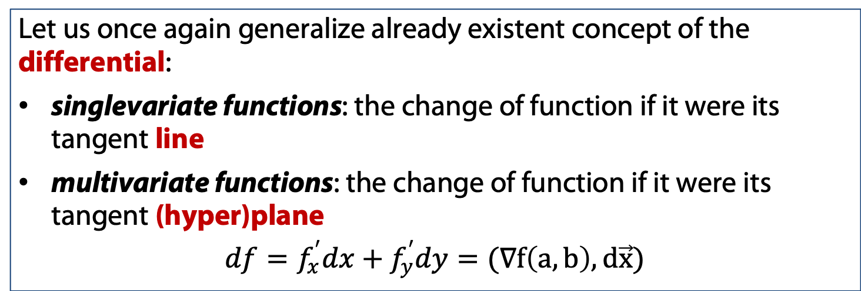
First and second differentials
Let us once again generalize already existent concept of the differential:
singlevariate functions: the change of function if it were its tangent line
multivariate functions: the change of function if it were its tangent (hyper)plane
$$df=f_{x}^{′}dx+f_{y}^{′}dy=(∇f\left(a,b\right), d\vec{x})$$

Slide 66

First and second differentials
Let us once again generalize already existent concept of the differential:
singlevariate functions: the change of function if it were its tangent line
multivariate functions: the change of function if it were its tangent (hyper)plane
$$df=f_{x}^{′}dx+f_{y}^{′}dy=(∇f\left(a,b\right), d\vec{x})$$
Example: $f\left(x,y,z\right)={\left(\frac{x}{y}\right)}^{z}$

Slide 67

First and second differentials
Operator notation:
$$df=\frac{∂f}{∂x}dx+\frac{∂f}{∂y}dy=\left[\frac{∂}{∂x}dx+\frac{∂}{∂y}dy\right]f$$

Slide 68

First and second differentials
Operator notation:
$$df=\frac{∂f}{∂x}dx+\frac{∂f}{∂y}dy=\left[\frac{∂}{∂x}dx+\frac{∂}{∂y}dy\right]f$$
$$d(⋅)=\frac{∂(⋅)}{∂x}dx+\frac{∂(⋅)}{∂y}dy$$

Slide 69

First and second differentials
Operator notation:
$$df=\frac{∂f}{∂x}dx+\frac{∂f}{∂y}dy=\left[\frac{∂}{∂x}dx+\frac{∂}{∂y}dy\right]f$$
$$d(⋅)=\frac{∂(⋅)}{∂x}dx+\frac{∂(⋅)}{∂y}dy$$
Then let us find the second differential $d^{2}f$:
$$d^{2}f=d\left[df\right]=d\left[f_{x}^{′}dx+f_{y}^{′}dy\right]$$
$$d^{2}f={\left[\frac{∂}{∂x}dx+\frac{∂}{∂y}dy\right]}^{2}f$$

Slide 70
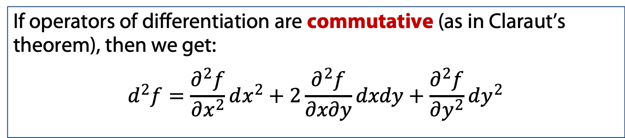
First and second differentials
Operator notation:
$$df=\frac{∂f}{∂x}dx+\frac{∂f}{∂y}dy=\left[\frac{∂}{∂x}dx+\frac{∂}{∂y}dy\right]f$$
$$d(⋅)=\frac{∂(⋅)}{∂x}dx+\frac{∂(⋅)}{∂y}dy$$
Then let us find the second differential $d^{2}f$:
$$d^{2}f=d\left[df\right]=d\left[f_{x}^{′}dx+f_{y}^{′}dy\right]$$
$$d^{2}f={\left[\frac{∂}{∂x}dx+\frac{∂}{∂y}dy\right]}^{2}f$$
If operators of differentiation are commutative (as in Claraut’s theorem), then we get:
$$d^{2}f=\frac{∂^{2}f}{∂x^{2}}dx^{2}+2\frac{∂^{2}f}{∂x∂y}dxdy+\frac{∂^{2}f}{∂y^{2}}dy^{2}$$

Slide 71

First and second differentials
Then let us find the second differential $d^{2}f$:
$$d^{2}f=d\left[df\right]=d\left[f_{x}^{′}dx+f_{y}^{′}dy\right]$$
$$d^{2}f={\left[\frac{∂}{∂x}dx+\frac{∂}{∂y}dy\right]}^{2}f$$
Example: find $d^{2}f$ and $d^{n}f$ for $f\left(x,y\right)=e^{ax+by}$

Slide 72
Convexity

Slide 73
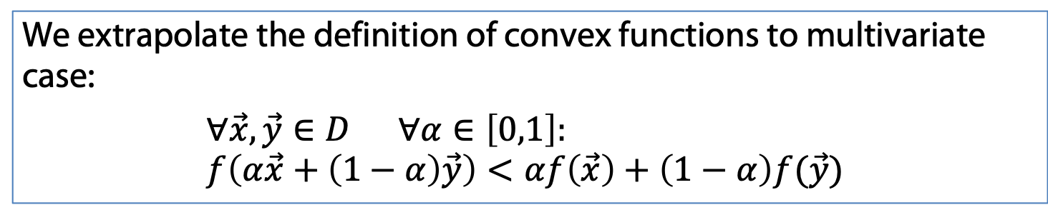
Second partial derivatives: convexity
We extrapolate the definition of convex functions to multivariate case:
$$∀\vec{x},\vec{y}∈D ∀α∈\left[0,1\right]: \\ f\left(α\vec{x}+\left(1−α\right)\vec{y}\right)<αf\left(\vec{x}\right)+\left(1−α\right)f(\vec{y})$$

Slide 74
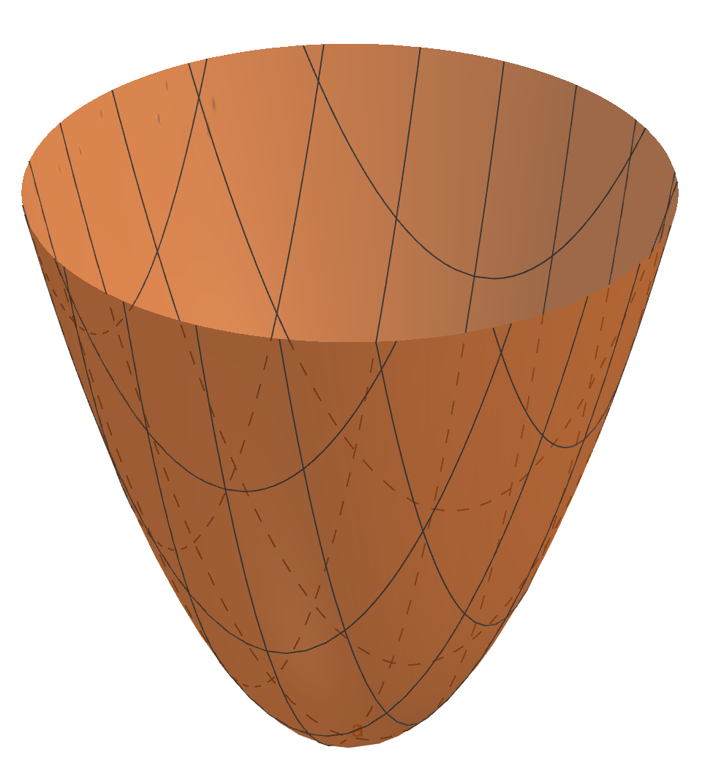
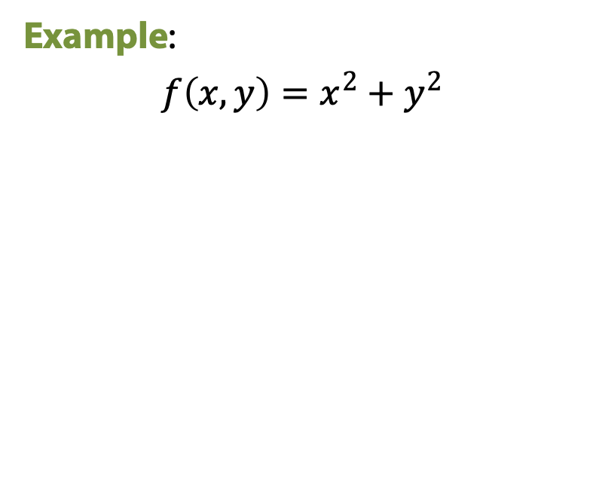
Second partial derivatives: convexity
We extrapolate the definition of convex functions to multivariate case:
$$∀\vec{x},\vec{y}∈D ∀α∈\left[0,1\right]: \\ f\left(α\vec{x}+\left(1−α\right)\vec{y}\right)<αf\left(\vec{x}\right)+\left(1−α\right)f(\vec{y})$$
Example:
$$f\left(x,y\right)=x^{2}+y^{2}$$

Slide 75
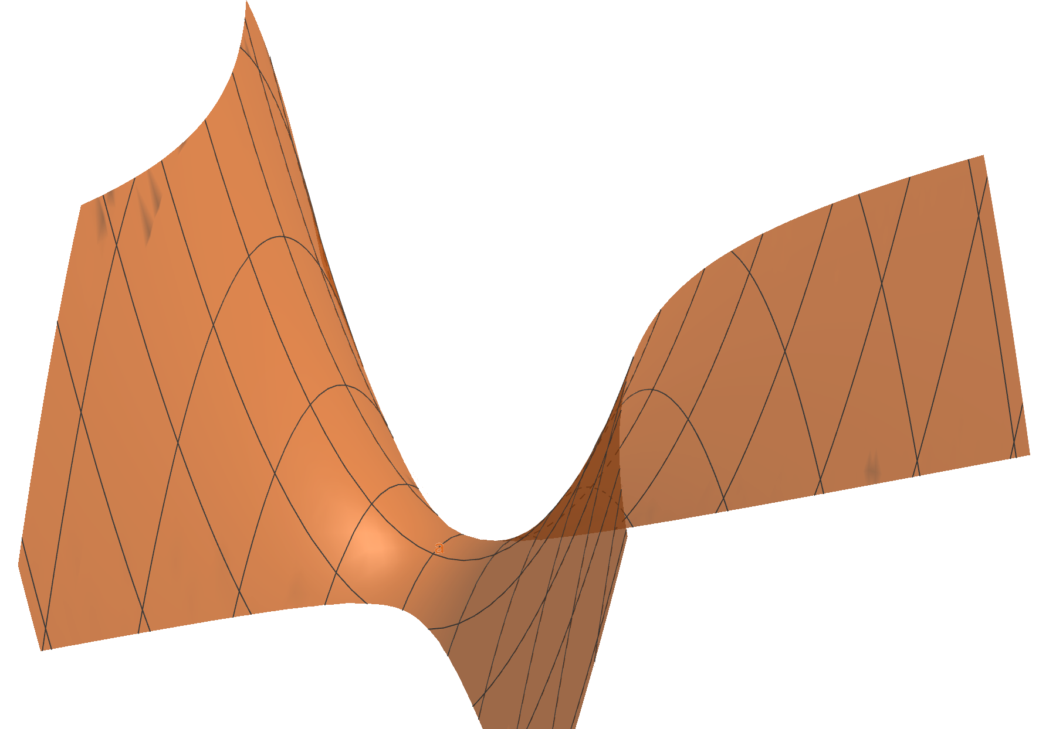

Second partial derivatives: convexity
We extrapolate the definition of convex functions to multivariate case:
$$∀\vec{x},\vec{y}∈D ∀α∈\left[0,1\right]: \\ f\left(α\vec{x}+\left(1−α\right)\vec{y}\right)<αf\left(\vec{x}\right)+\left(1−α\right)f(\vec{y})$$
Example:
$$f\left(x,y\right)=x^{2}−y^{2}$$

Slide 76
Second partial derivatives: convexity

Slide 77

Second partial derivatives: convexity
We extrapolate the definition of convex functions to multivariate case:
$$∀\vec{x},\vec{y}∈D ∀α∈\left[0,1\right]: \\ f\left(α\vec{x}+\left(1−α\right)\vec{y}\right)<αf\left(\vec{x}\right)+\left(1−α\right)f(\vec{y})$$
In case of single variable, the function is convex if $f^{′′}\left(x\right)>0$:
$$if f^{′′}\left(x\right)>0⟹f^{′′}\left(x\right)dx^{2}>0⟹d^{2}f>0 for all dx$$

Slide 78
Second partial derivatives: convexity
We extrapolate the definition of convex functions to multivariate case:
$$∀\vec{x},\vec{y}∈D ∀α∈\left[0,1\right]: \\ f\left(α\vec{x}+\left(1−α\right)\vec{y}\right)<αf\left(\vec{x}\right)+\left(1−α\right)f(\vec{y})$$
In case of single variable, the function is convex if $f^{′′}\left(x\right)>0$:
$$if f^{′′}\left(x\right)>0⟹f^{′′}\left(x\right)dx^{2}>0⟹d^{2}f>0 for all dx$$
Function $f\left(\vec{x}\right)$ is convex if $d^{2}f>0$ for all $d\vec{x}$.

Slide 79
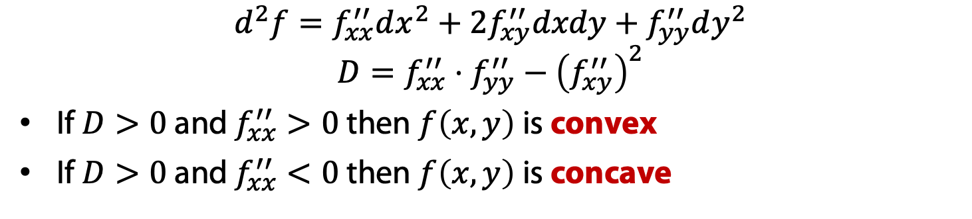
Second partial derivatives: convexity
We extrapolate the definition of convex functions to multivariate case:
$$∀\vec{x},\vec{y}∈D ∀α∈\left[0,1\right]: \\ f\left(α\vec{x}+\left(1−α\right)\vec{y}\right)<αf\left(\vec{x}\right)+\left(1−α\right)f(\vec{y})$$
In case of single variable, the function is convex if $f^{′′}\left(x\right)>0$:
$$if f^{′′}\left(x\right)>0⟹f^{′′}\left(x\right)dx^{2}>0⟹d^{2}f>0 for all dx$$
Function $f\left(\vec{x}\right)$ is convex if $d^{2}f>0$ for all $d\vec{x}$.
$$d^{2}f=f_{xx}^{′′}dx^{2}+2f_{xy}^{′′}dxdy+f_{yy}^{′′}dy^{2}$$
$$D=f_{xx}^{′′}⋅f_{yy}^{′′}−{\left(f_{xy}^{′′}\right)}^{2}$$
If $D>0$ and $f_{xx}^{′′}>0$ then $f\left(x,y\right)$ is convex
If $D>0$ and $f_{xx}^{′′}<0$ then $f\left(x,y\right)$ is concave

Slide 80
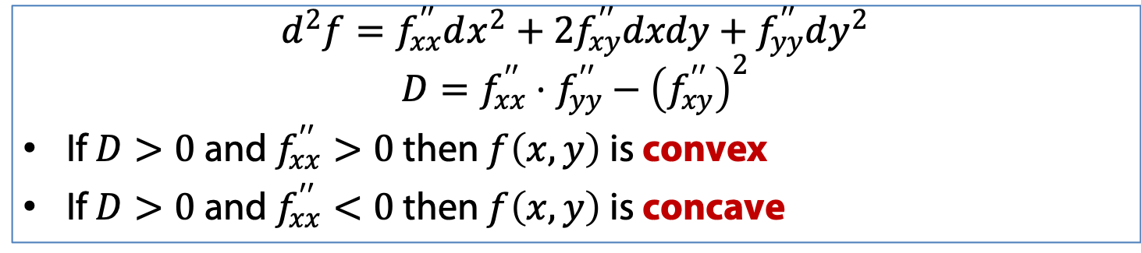
Second partial derivatives: convexity
$$d^{2}f=f_{xx}^{′′}dx^{2}+2f_{xy}^{′′}dxdy+f_{yy}^{′′}dy^{2}$$
$$D=f_{xx}^{′′}⋅f_{yy}^{′′}−{\left(f_{xy}^{′′}\right)}^{2}$$
If $D>0$ and $f_{xx}^{′′}>0$ then $f\left(x,y\right)$ is convex
If $D>0$ and $f_{xx}^{′′}<0$ then $f\left(x,y\right)$ is concave
Example: $f\left(x,y\right)=ax^{2}+by^{2}+cxy$

Slide 81
Derivatives and linear approximations: multivariate functions

